Slide 1
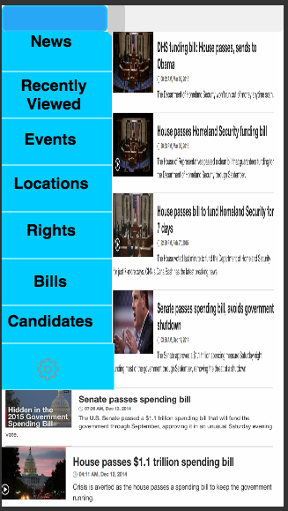
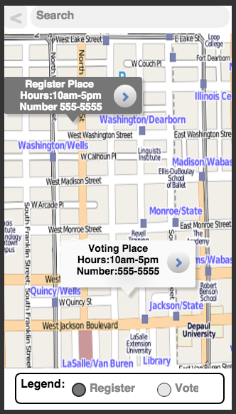
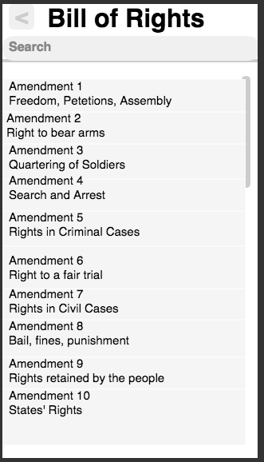
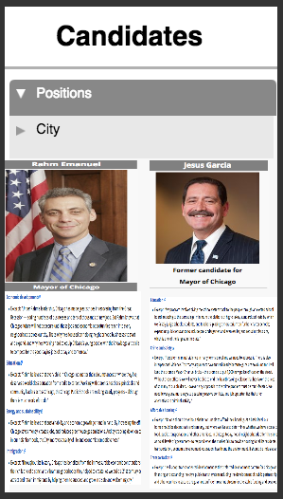
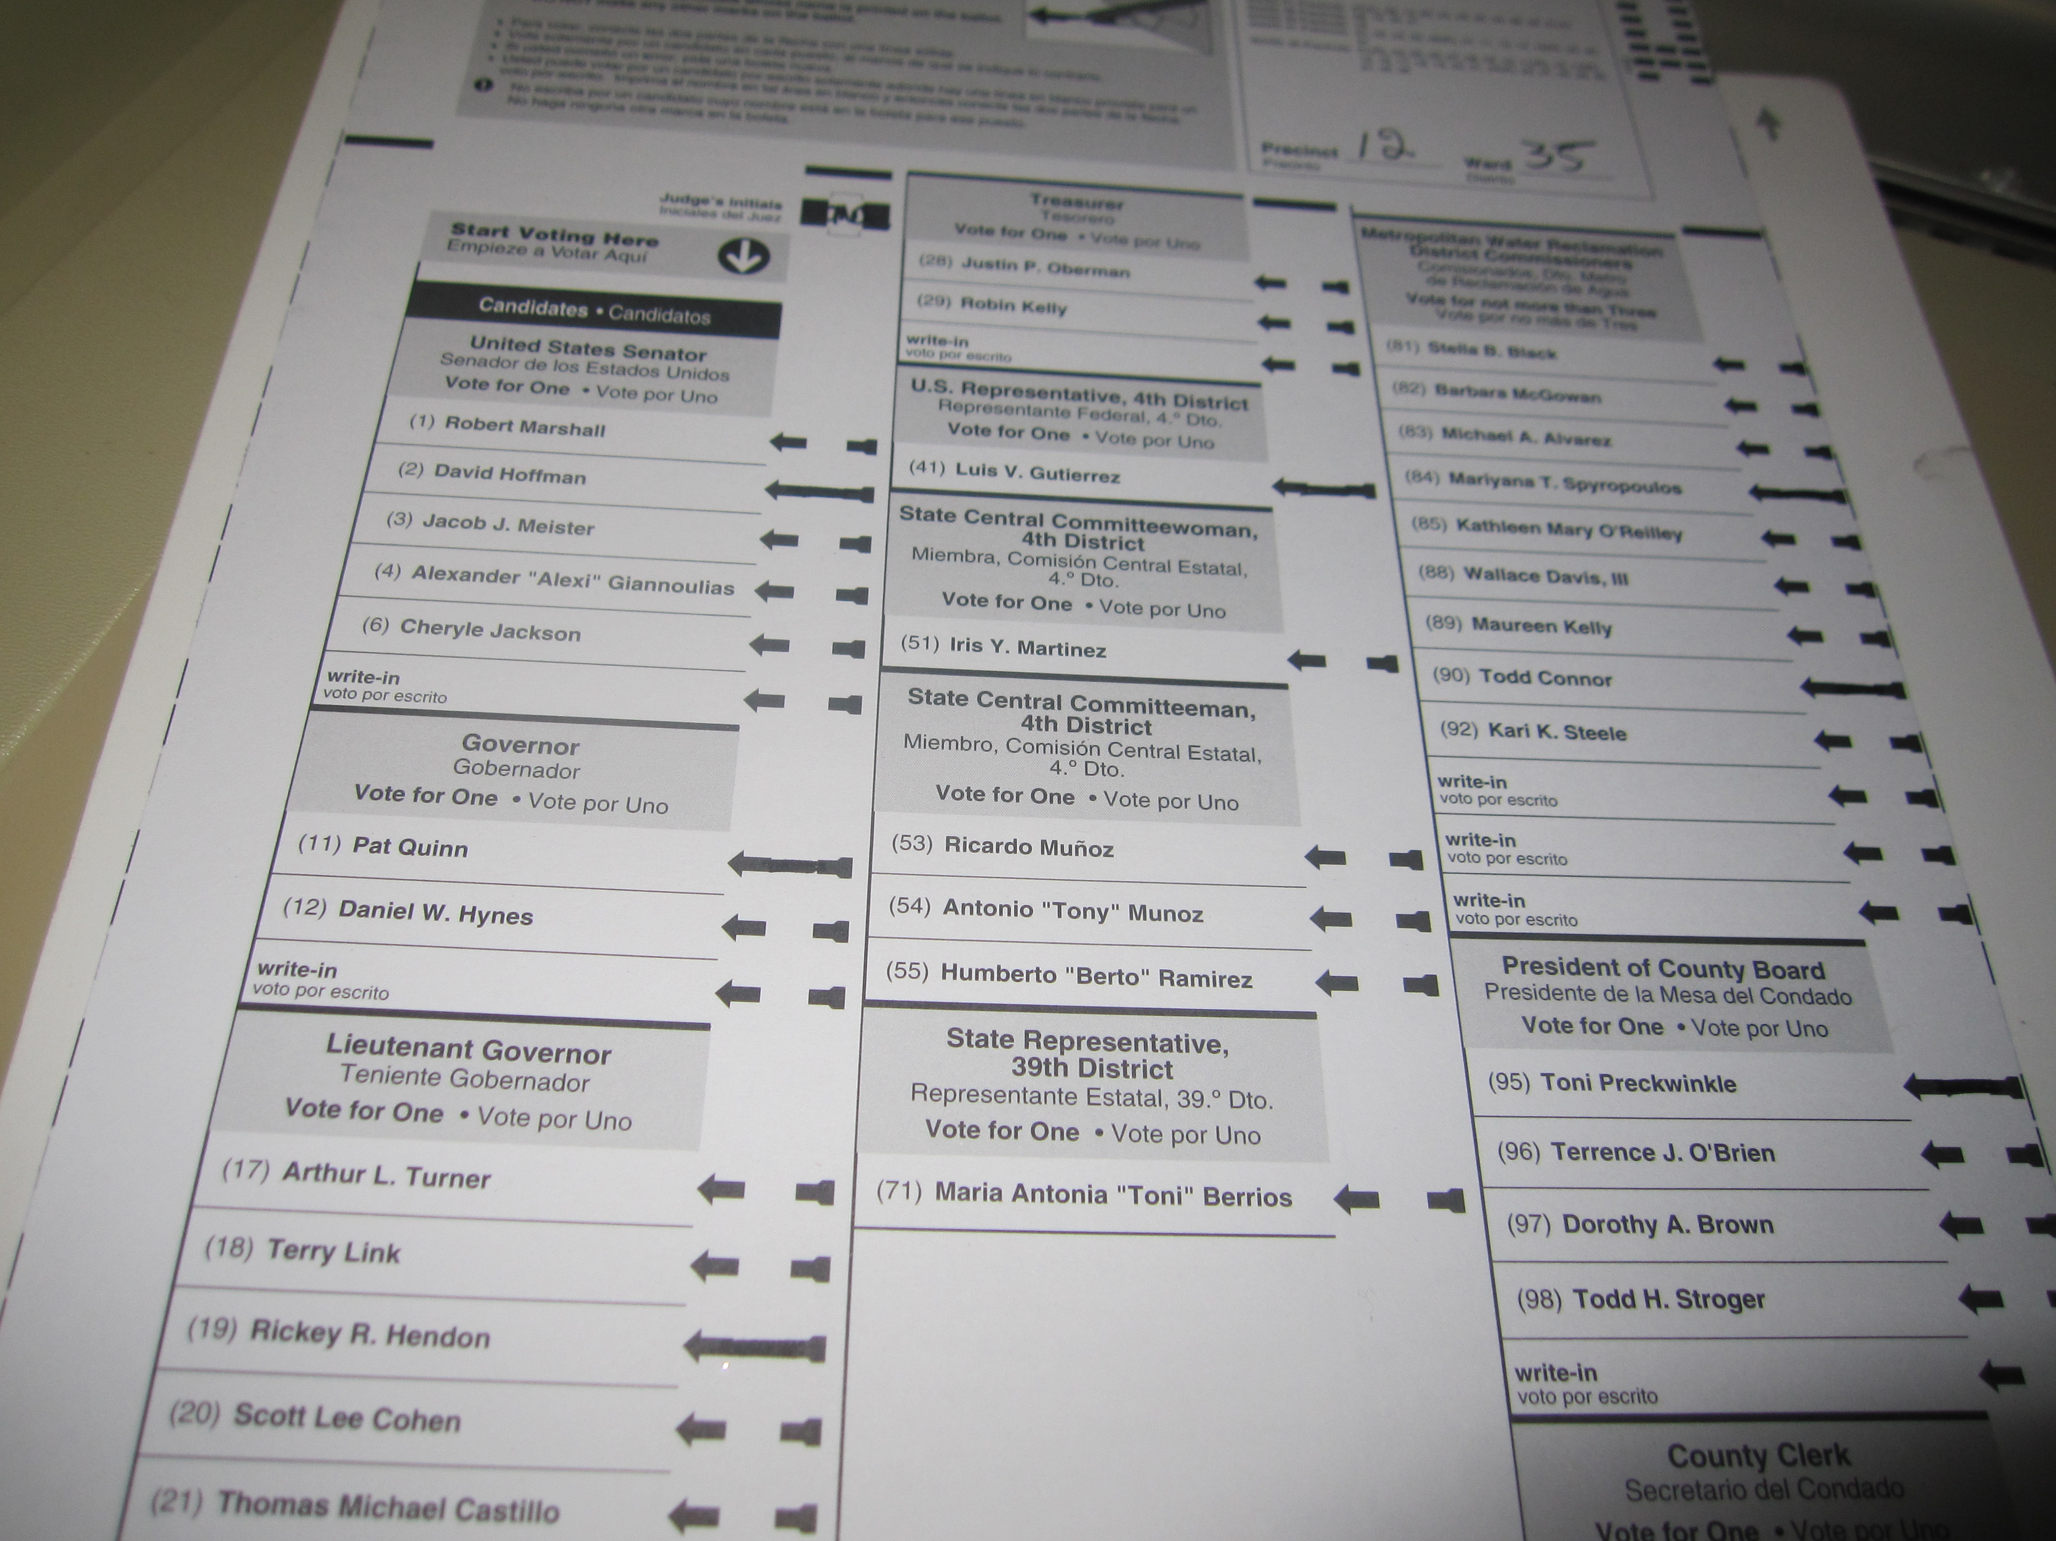
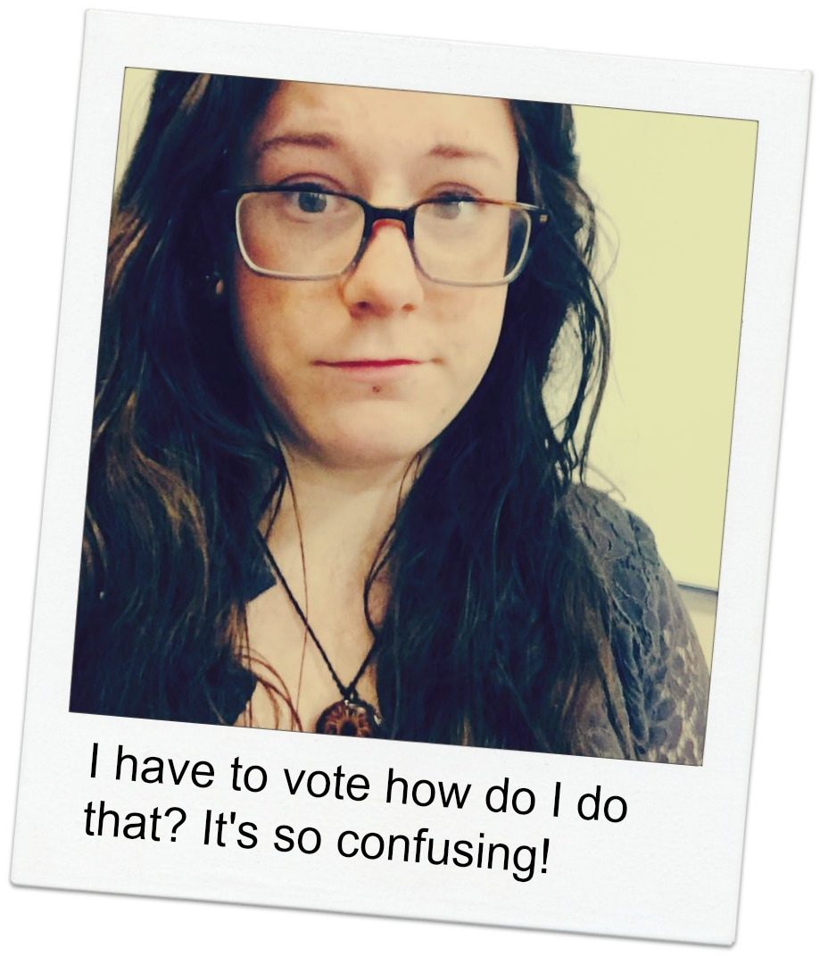
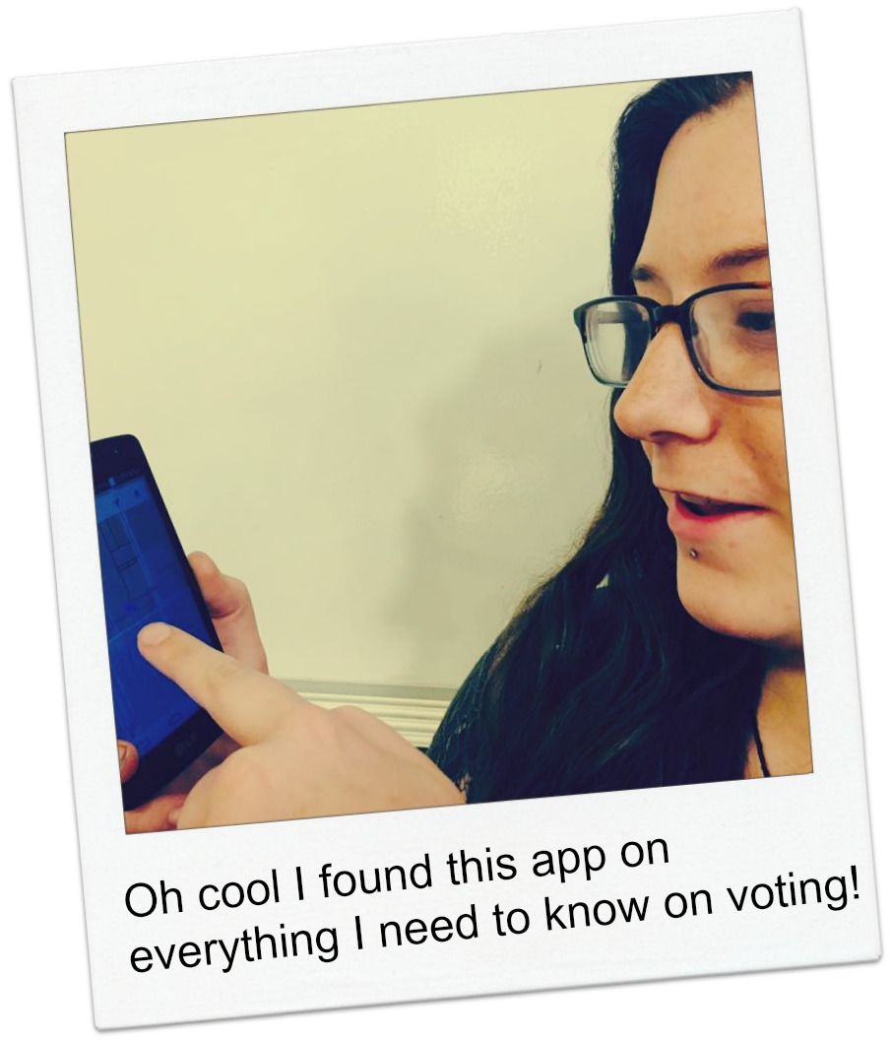
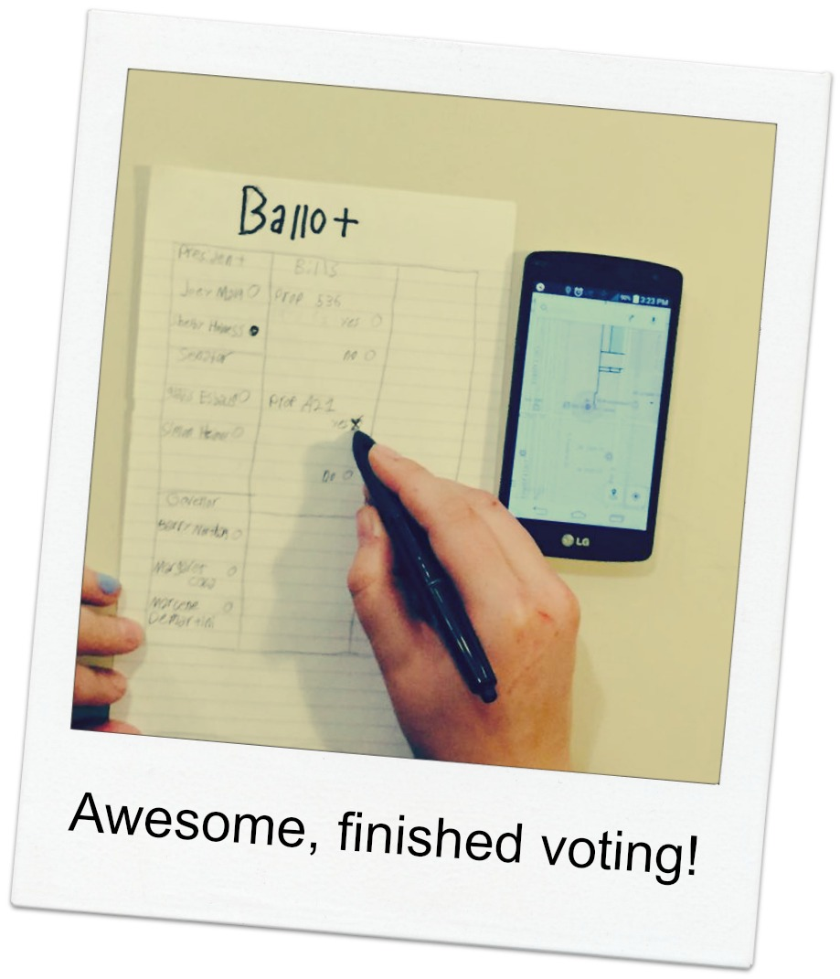
CIVIFY
What is this?
Civify is an app that provides information on everyday politics, rights, and bills as well as current elections in Chicago.
What it does?
Civify helps you stay informed on politics. The app displays the nearest registration and voting locations. It gives non biased, snapshots of candidates running for office. As well as notifies when new Bills are passed and sends reminders on election days. And details a list of constitutional rights.
y
How does this benefit you?
Civify makes voting simple and easy.
Civify gives non biased information on candidates running for office.
Illinois Institute of Technology | IPRO 397 | Spring 2015
Justice Mosquera, Caroline Segre, Colin Redmond

